Slide 1
Part 1: overview
Principal Component Analysis (PCA)
Partial Least Squares (PLS)
Two-way Orthogonal PLS (O2PLS)
Group sparse O2PLS
Post-hoc analyses using external databases
String-DB and gene enrichment
Notes:
Theory 5 – 10 min
Data

Slide 2
Overview
Recap go2pls and selected genes
Genes and their annotation
Categories
Enrichment in gene list
Using bioinformatics databases
Visualizing enrichment

Slide 3
Background
Data integration with OmicsPLS
Using the methylation and glycomics datasets, several genes selected
These genes are important to consider
What do they tell us?

Slide 4
Genes and their meaning
Vast amount of information available on genes
Functionality, location, interactions, etc
Many bioinformatics tools that organize this information
Apply these tools to the selected genes

Slide 5
Bioinformatics tools
String-DB database
A collection of gene-gene interactions based on several sources of evidence
https://string-db.org/
Also available as an R package for reproducible research

Slide 6
String-DB: input
Open website, go to multiple proteins
Try an example list, click on #1
Input list of names, and organism
Review the gene list and continue
A network based on the gene list appears
Interactive, so almost everything is clickable
Review basic settings to customize the network
Most important: Interaction source and confidence

Slide 7
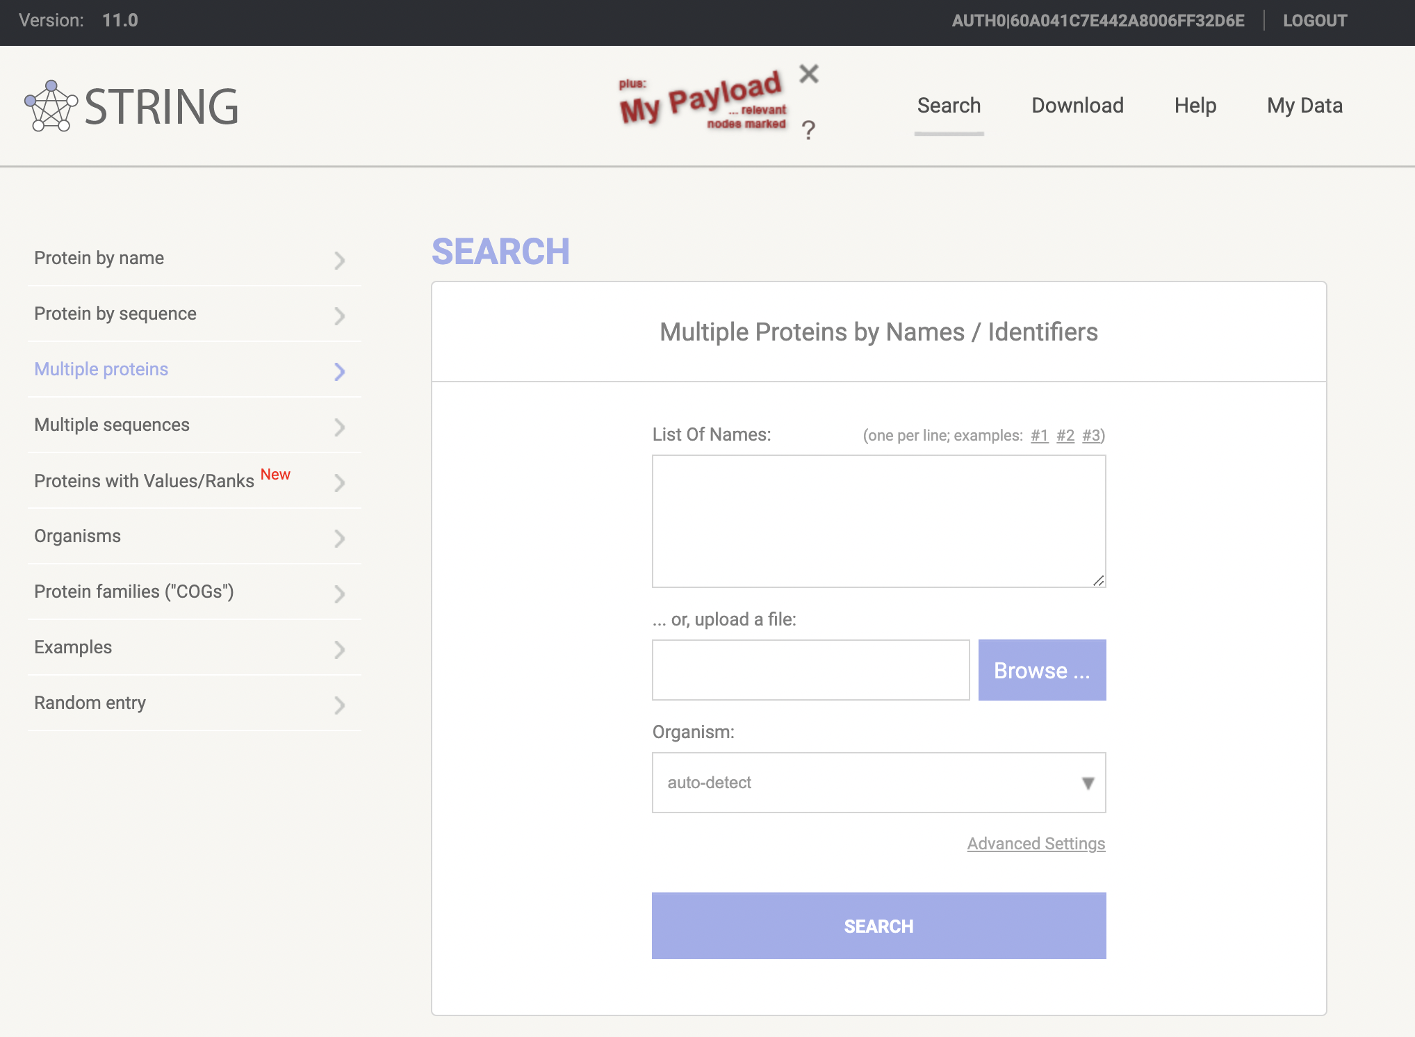
String-DB: input and output

Slide 8
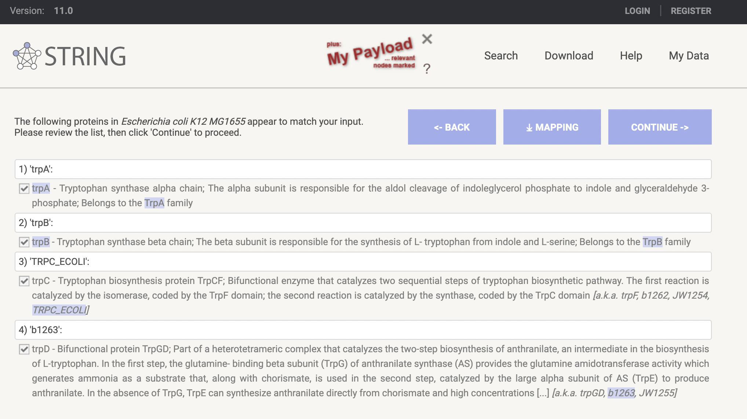
String-DB: input and output

Slide 9
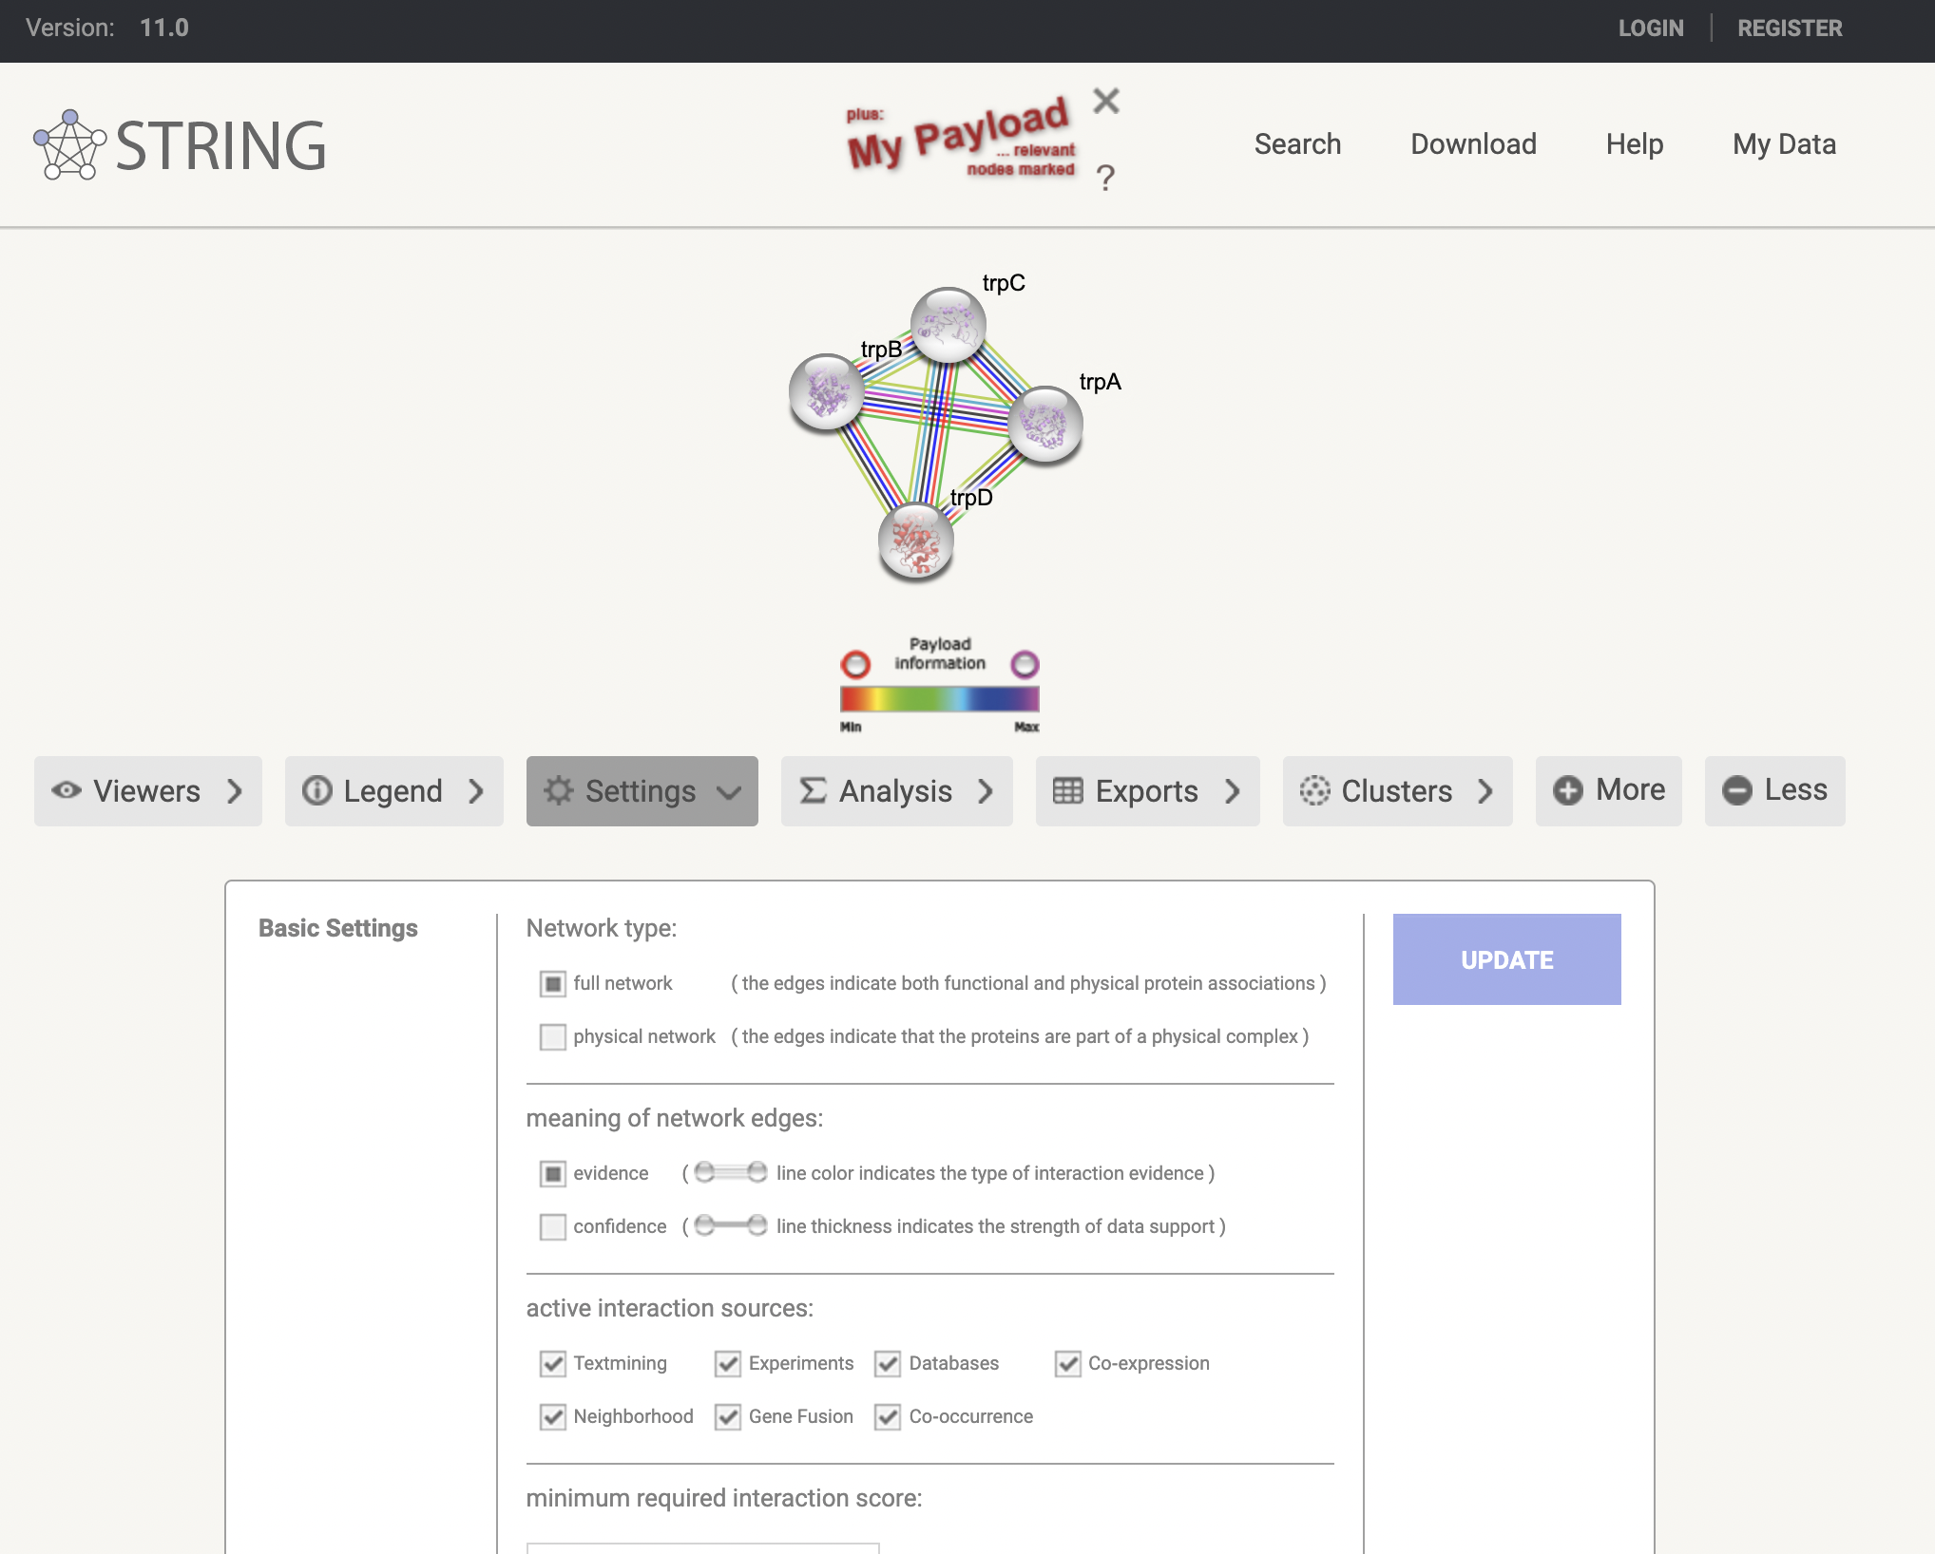
String-DB: input and output

Slide 10
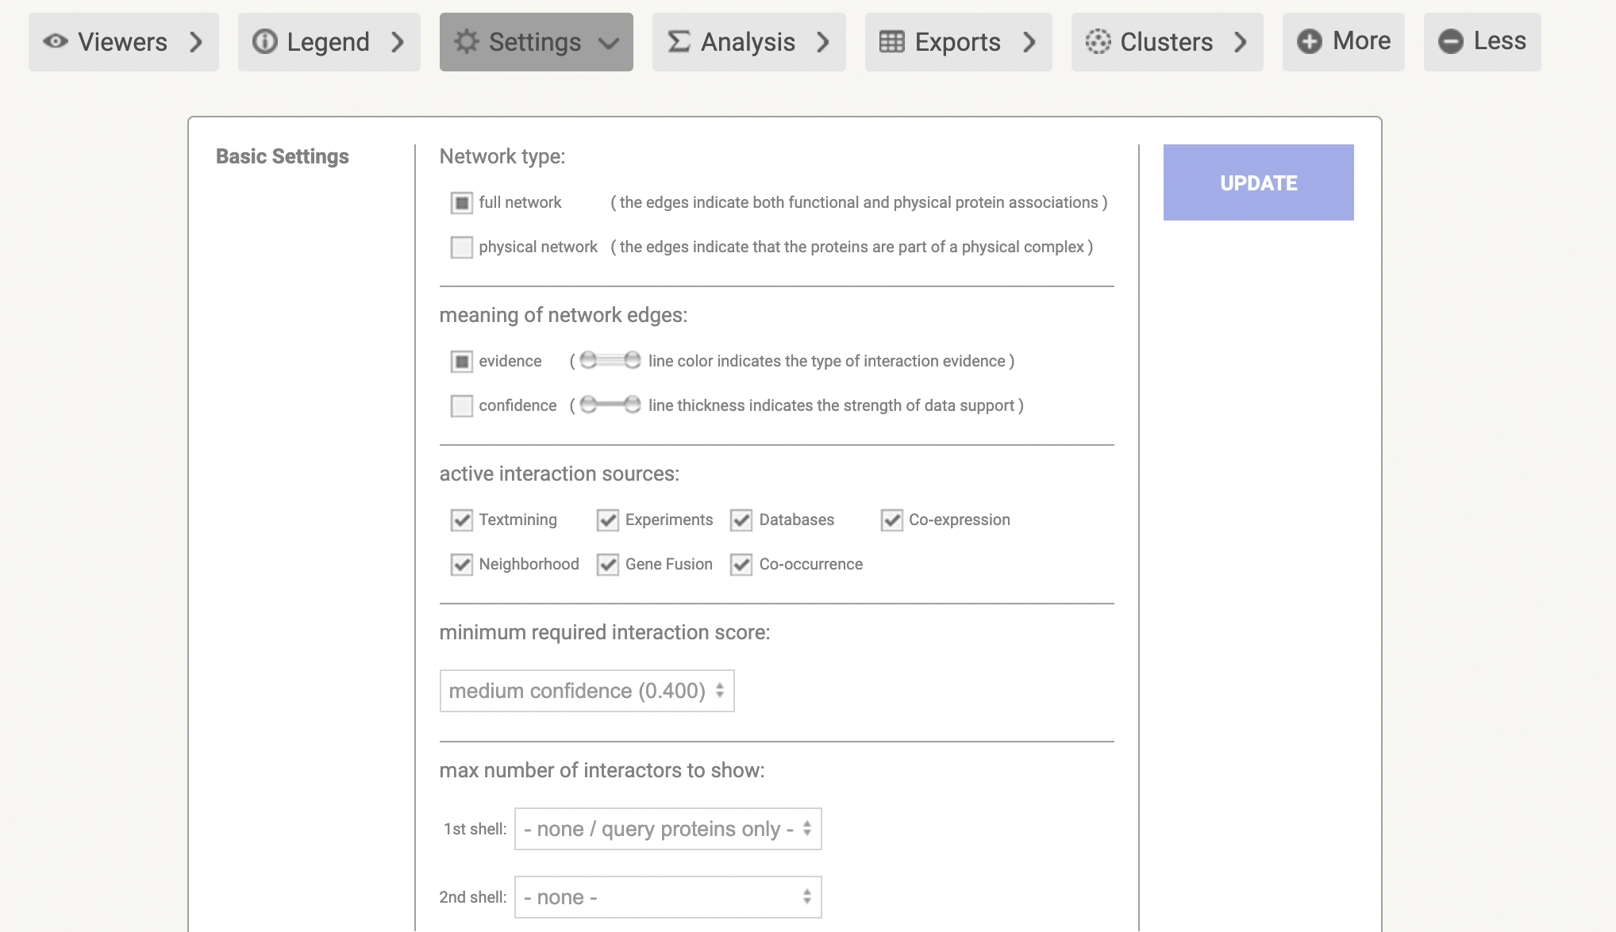
String-DB: input and output

Slide 11
String-DB: output
String network
Network of interactions between genes
7 metrics that form a combined score
How likely is it that this link is biologically relevant?
Enrichment analysis
Are certain pre-defined gene categories overrepresented in our gene list?
Many types of categories (experimental, text-mining, etc)

Slide 12
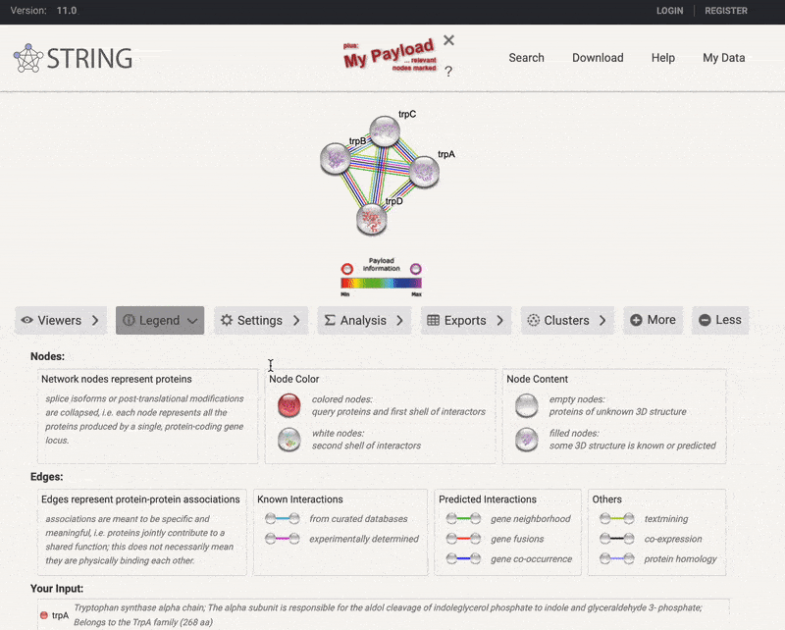
String-DB: output

Slide 13
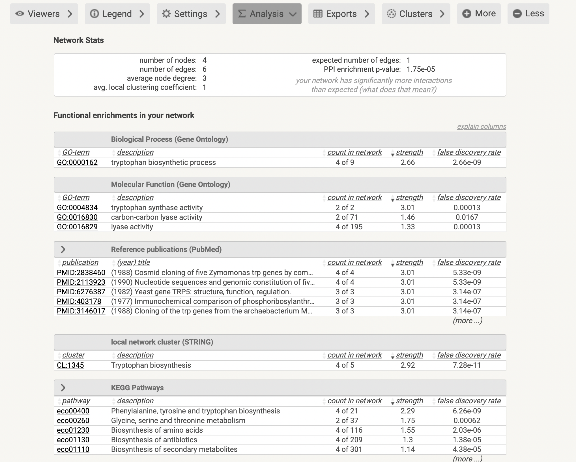
String-DB: input and output

Slide 14
OmicsPLS to String-DB workflow
Estimate important genes using OmicsPLS
Input in String-DB
Interpret clusters and annotations

Slide 15
Another gene enrichment tool
In the exercises we will also consider DisGeNet
A database of gene-disease associations
Contains information about potential links between gene sets and diseases
https://www.disgenet.org/
Also available as an R package for enrichment analysis

Slide 16
Part 1: overview
Principal Component Analysis (PCA)
Partial Least Squares (PLS)
Two-way Orthogonal PLS (O2PLS)
Group sparse O2PLS
Post-hoc analyses using external databases
String-DB and gene enrichment
Notes:
Theory 5 – 10 min
Data

